Slide 1
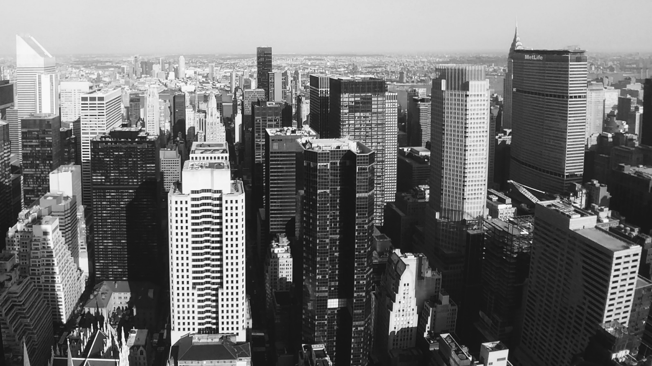
Diapositiva 1
THE BATTLE OF NEIGHBORHOODS AND VENUES
IBM Data Science Course – Capstone Project

Slide 2
INTRODUCTION
INTRODUCTION
Toronto City, Canada
BUSINESS PROBLEM
People interested to invest in a small business or shop store but they don’t know well Toronto
DATA
Wikipeda: Postal Codes of Toronto
Geoespatial Coordinates: Coordinates of Postal codes of Toronto
Foursquare API: Information of venues

Slide 3
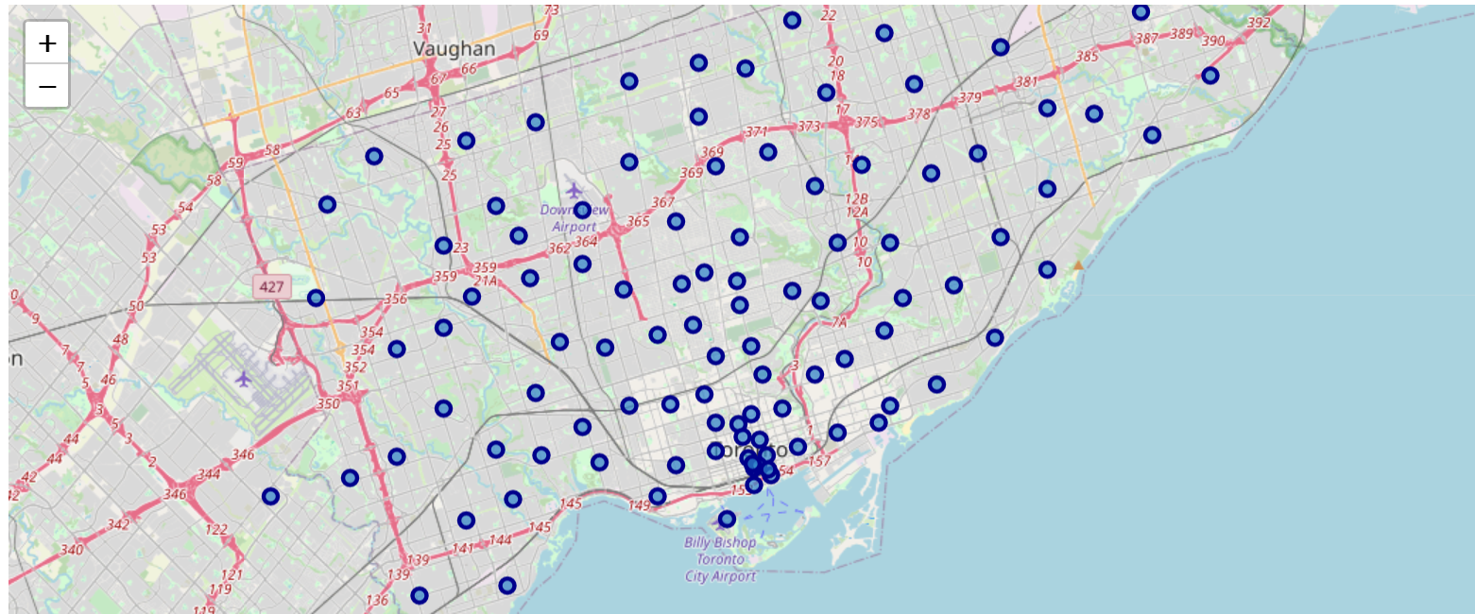
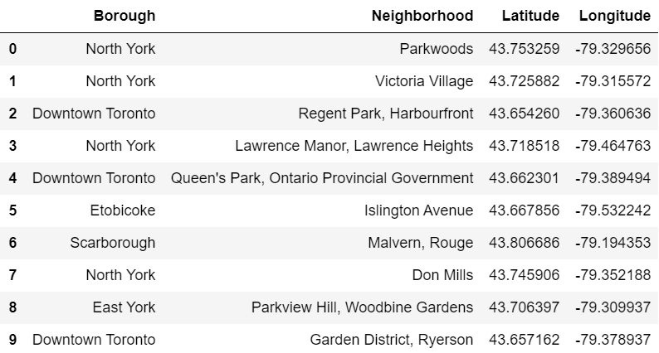
Location of neighborhoods in Toronto

Slide 4
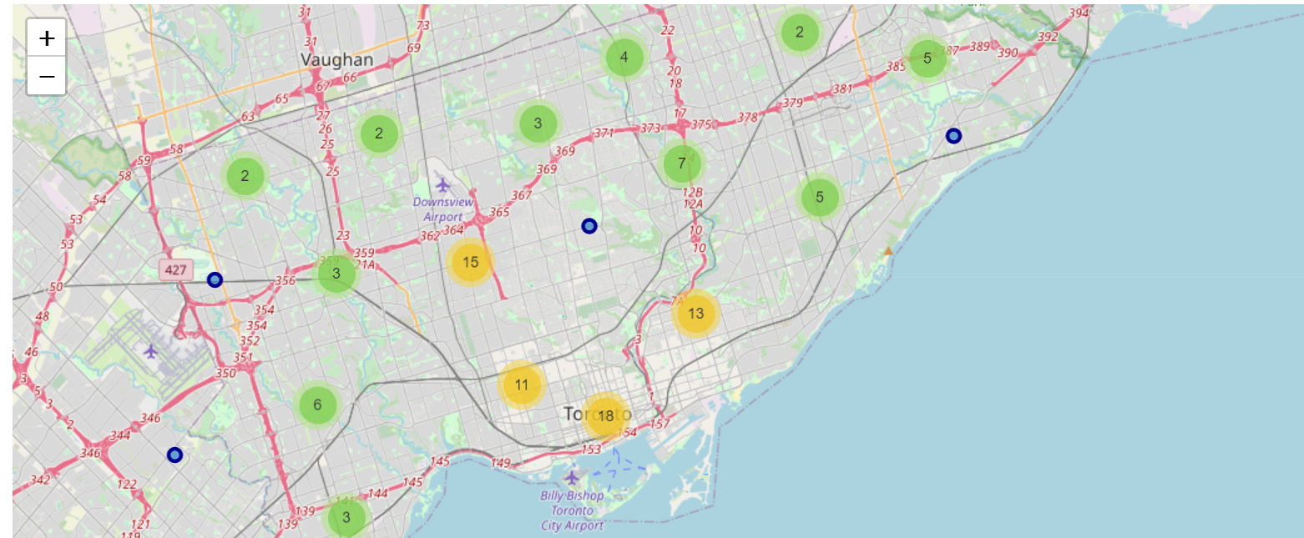
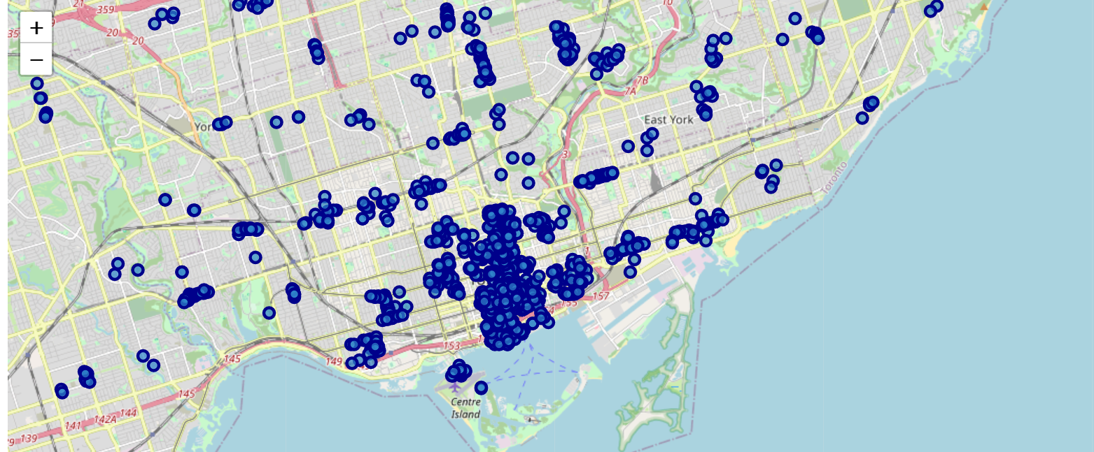
Density of neighborhoods and venues in Toronto city

Slide 5
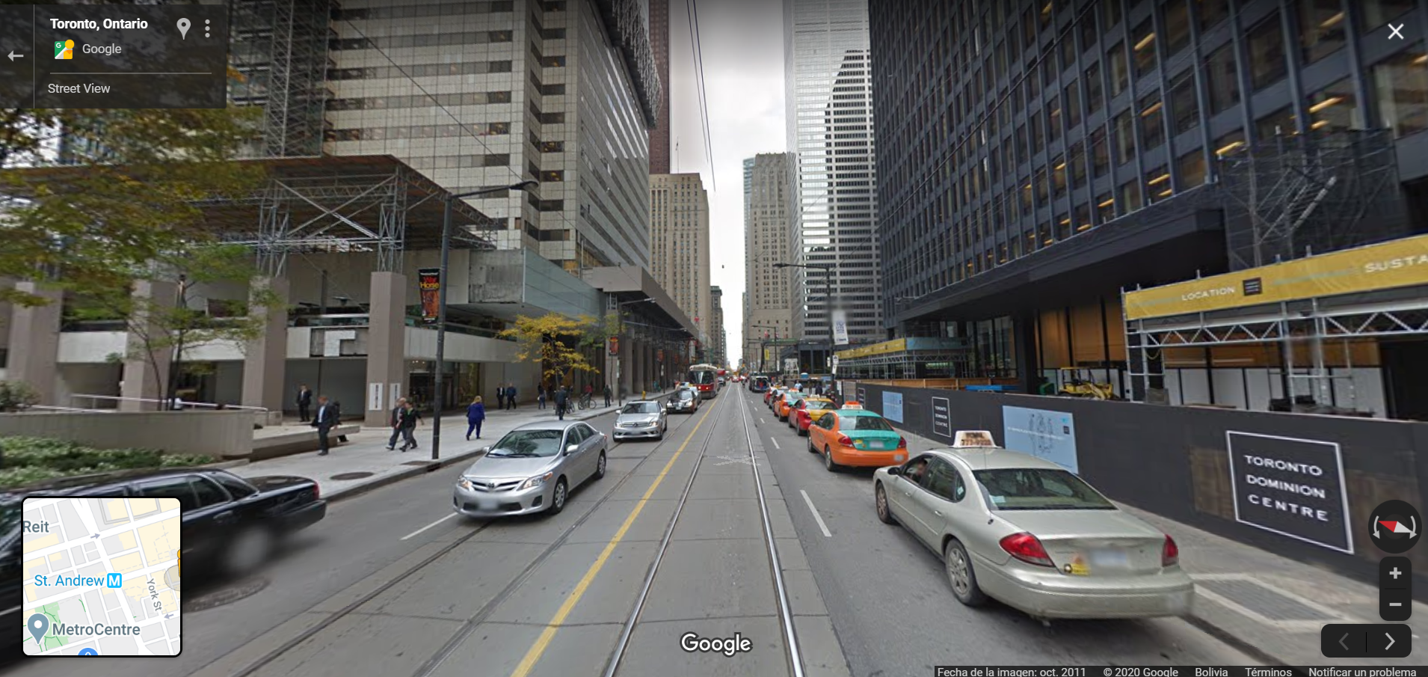
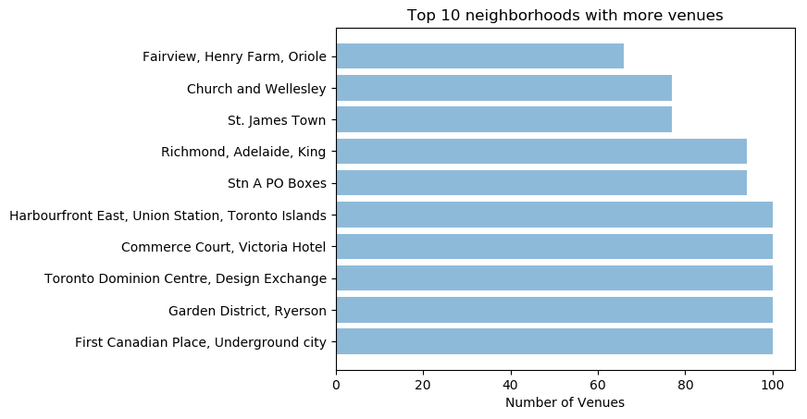
Top 10 neighborhoods with more venues in Toronto

Slide 6
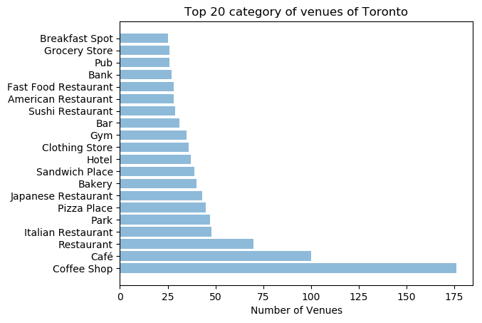
Top 20 category of venues of Toronto

Slide 7
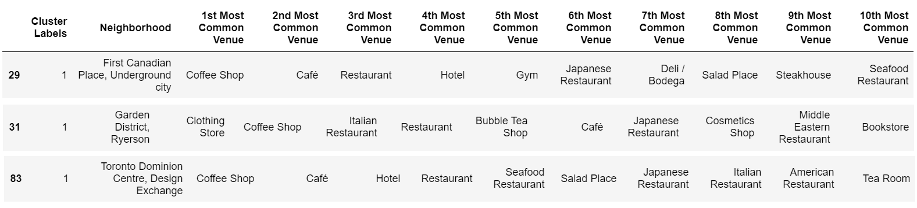
Top 10 categories of venues for three main neighborhoods studied

Slide 8
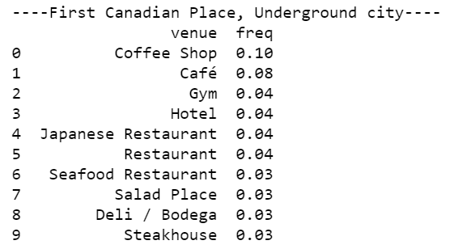
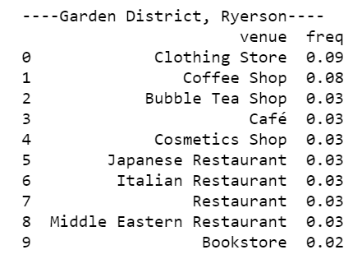
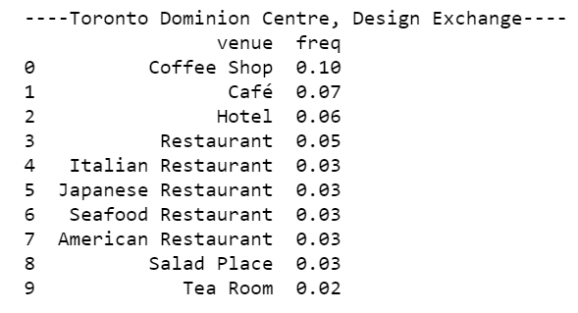
Tables of frequency of the three neighborhood studied

Slide 9
CONCLUSION
The main neighborhoods to invest according to the number of its venues are:
First Canadian Place, Underground City;
Garden District, Ryerson;
Toronto Dominion Centre, Design Exchange.
The main categories of venues or kind of business to invest in Toronto are:
Coffee Shops;
Restaurants.
We recommend investing in a “Coffee Shop” in “Garden District, Ryerson”.

Slide 10

Diapositiva 11
GRACIAS

